Slide 1
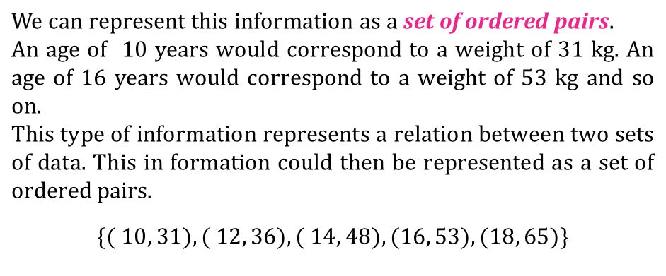
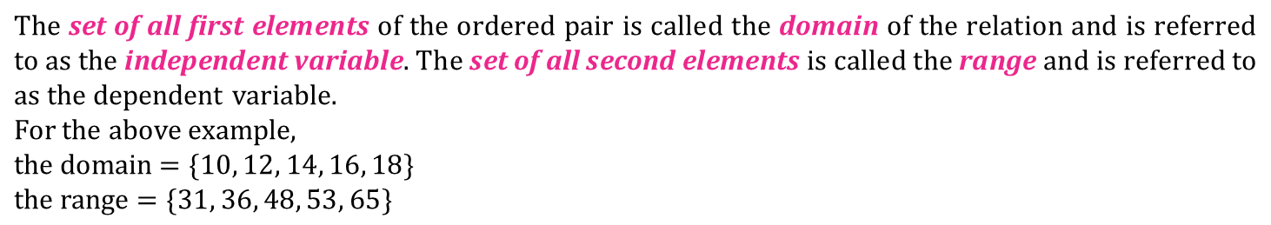


RELATION
A
Consider the relationship between the weight of five students and their ages as shown below.
Age (years) | Weight (kg)
10 | 31
12 | 36
14 | 48
16 | 53
18 | 65
corresponds to
Domain
defining
relationship
Range
[Independent variable]
[Dependent variable]

Slide 2
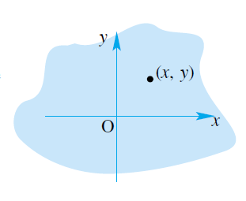
RELATION
A
Relation
A relation is a correspondence between a first set, called the domain, and a second set, called the range, such that each member of the domain corresponds to at least one member of the range.

Slide 3
FUNCTIONS
B
Functions are special relations.
Every set of ordered pairs is a relation, but every relation is not a function
Functions make up a subset of all relations.
A function is defined as a relation that is either one to one or many to one., i.e. no ordered pairs have the same first element.

Slide 4
Identify the Domain and Range. Then tell if the relation is a function.
Input Output
-3 3
1 1
3 -2
4
Function?
Yes: each input is mapped
onto exactly one output
Domain = {-3, 1,3,4}
Range = {-2,1,3}

Slide 5
Identify the Domain and Range. Then tell if the relation is a function.
Input Output
-3 3
1 -2
4 1
4
Domain = {-3, 1,4}
Range = {3,-2,1,4}
Function?
No: input 1 is mapped onto
Both -2 & 1

Slide 6
The Vertical Line Test
If it is possible for a vertical line to intersect a graph at more than one point, then the graph is NOT the graph of a function.

Slide 7
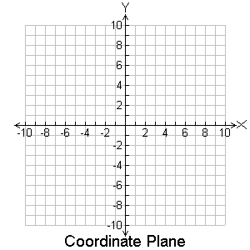
Use the vertical line test to visually check if the relation is a function.
(4,4)
(-3,3)
(1,1)
(1,-2)
Function?
No, Two points are on
The same vertical line.

Slide 8
Use the vertical line test to visually check if the relation is a function.
(-3,3)
(1,1)
(3,1)
(4,-2)
Function?
Yes, no two points are
on the same vertical line

Slide 9
Examples
I’m going to show you a series of graphs. **don’t write ☺
Determine whether or not these graphs are functions.
You do not need to draw the graphs in your notes. **or write this note

Slide 10
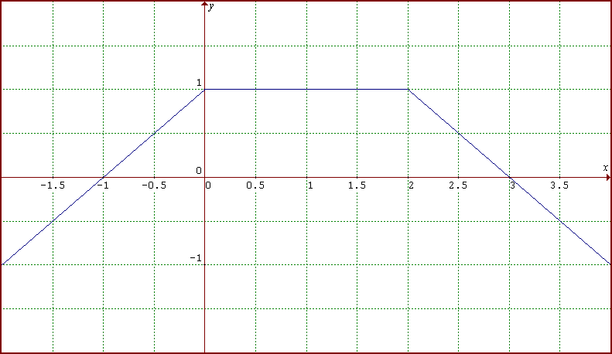
YES!
#1
Function?

Slide 11
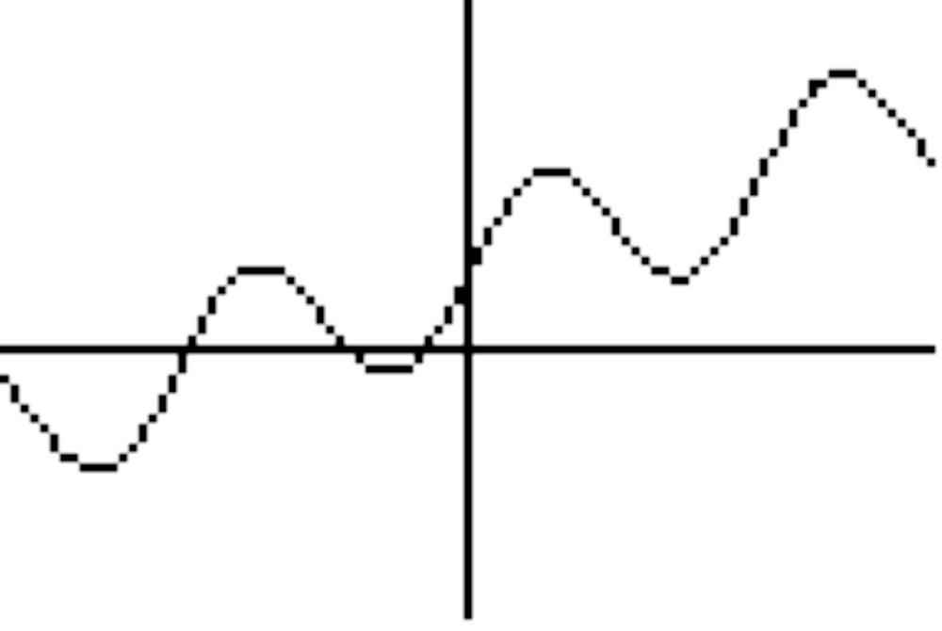
YES!
#2
Function?
Notes:
Y = 0.5x + 2 + 2sin(x)
D: all reals
R: all reals
Another cool function: abs(x) + 2sin(x)

Slide 12
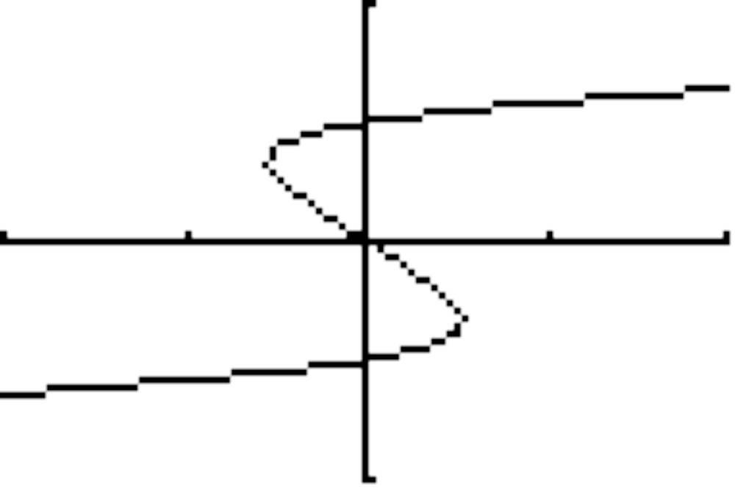
#3
Function?
NO!
Notes:
Y = 0.5x + 2 + 2sin(x)
D: all reals
R: all reals
Another cool function: abs(x) + 2sin(x)

Slide 13
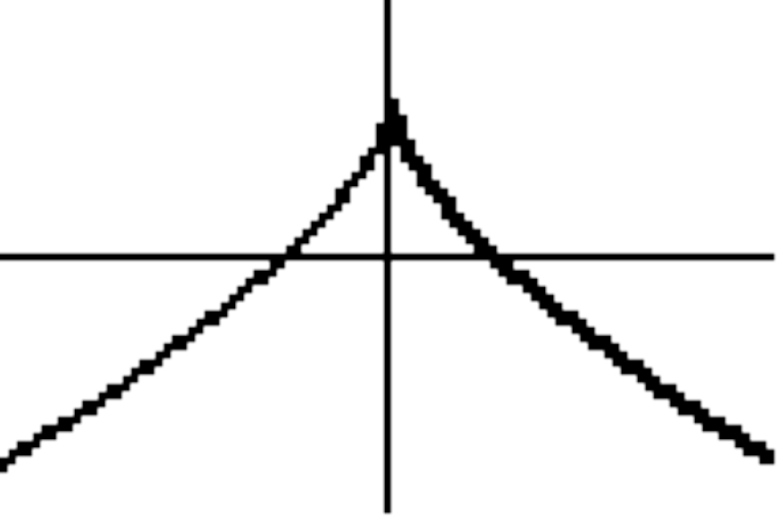
YES!
#4
Function?
Notes:
Y = 0.5x + 2 + 2sin(x)
D: all reals
R: all reals
Another cool function: abs(x) + 2sin(x)

Slide 14
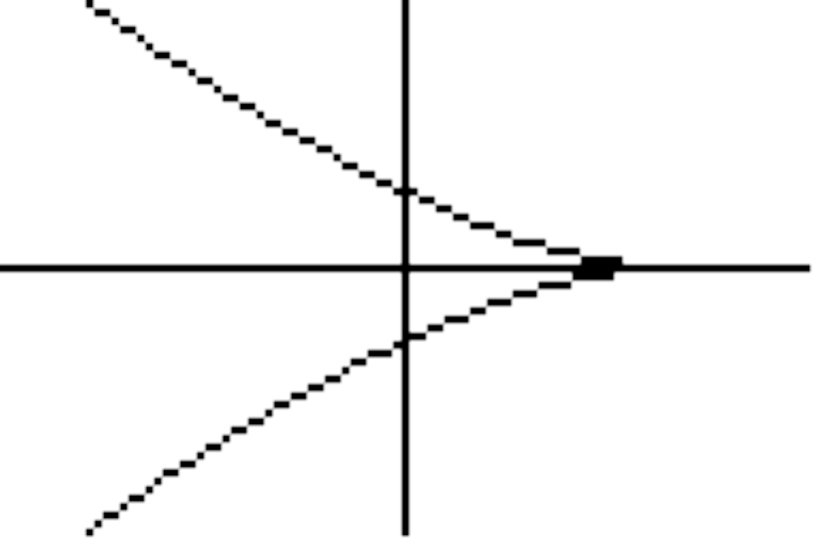
Function?
#5
NO!

Slide 15
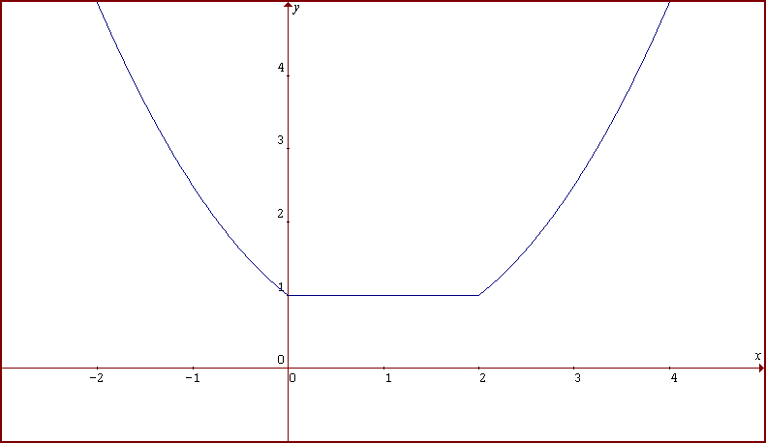
YES!
#6
Function?
Notes:
This is a piecewise function

Slide 16
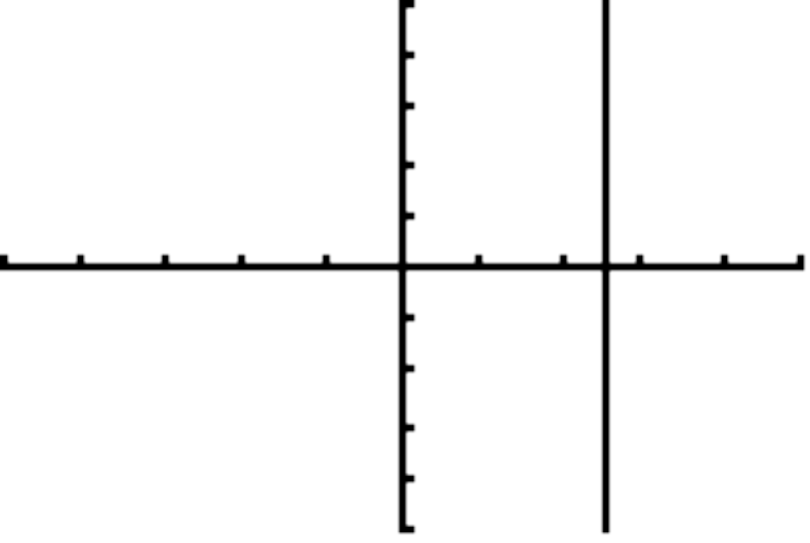
#7
Function?
NO!
Notes:
D: all reals
R: [0, 1]
Another cool function: y = sin(abs(x))
Y = sin(x) * abs(x)

Slide 17
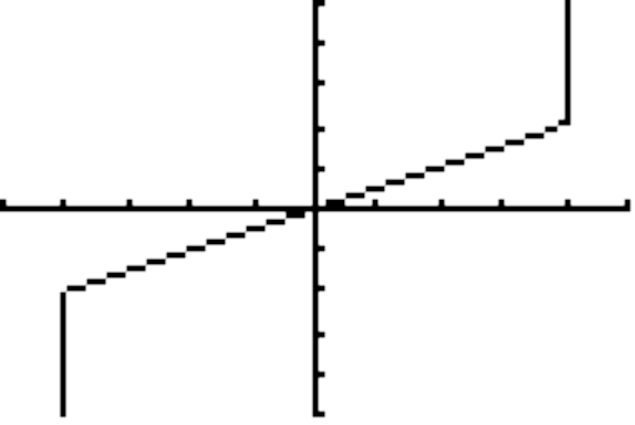
#8
Function?
NO!
Notes:
Y = 0.5x + 2 + 2sin(x)
D: all reals
R: all reals
Another cool function: abs(x) + 2sin(x)

Slide 18
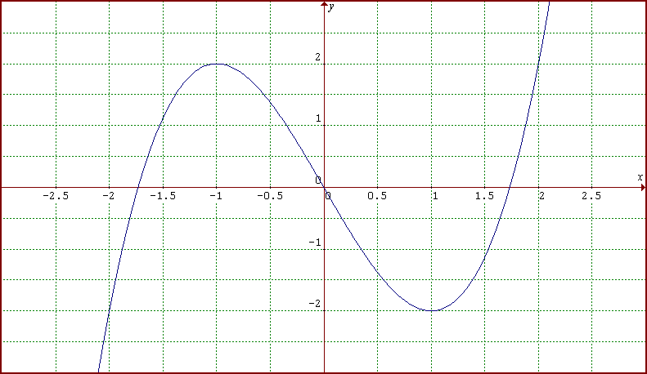
YES!
#9
Function?

Slide 19

Function Notation
“f of x”
Input = x
Output = f(x) = y

Slide 20
Before…
Now…
y = 6 – 3x
f(x) = 6 – 3x
x
y
x
f(x)
-2
-1
0
1
2
12
-2
-1
0
1
2
12
9
(x, y)
(x, f(x))
9
6
6
3
3
0
0
(input, output)

Slide 21
Example.
f(x) = 2x² – 3
Find f(0), f(-3), f(5).

Slide 22
Finding the Domain of a Function
When a function is defined by an equation and the domain of the function is not stated, we assume that the domain is
All Real Numbers
There will be certain cases where specific numbers cannot be included in the domain or a set of numbers cannot be included in the domain

Slide 23
Examples…
f(x) = 2x – 5
*there would be no restrictions on this, so the domain is All Real Numbers
g(x) = 1
x – 2
*a denominator cannot equal 0, so x ≠ 2. The domain is {x | x ≠ 2}
h(x) = √x + 6
*you cannot take the square root of a negative number, so x must be ≥ -6. The domain is {x | x ≥ -6}

Slide 24
Your Turn…Find the domain of each function
f(x) = x² + 2
g(x) = √x – 1
h(x) = 1
x + 5

